Slide 1
Chapter 15
Introduction to Rails
Programming the World Wide Web
Fourth edition
By Robert W. Sebesta

Slide 2
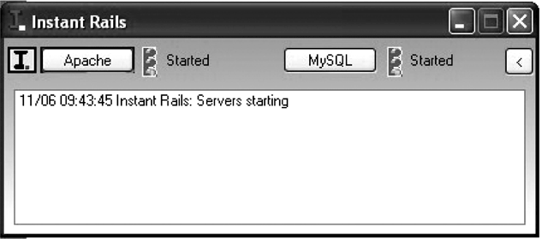
Figure 15.1 The InstantRails application window

Slide 3
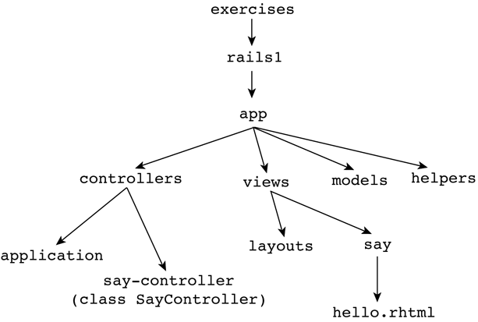
Figure 15.2 Directory structure for the rails1 application

Slide 4
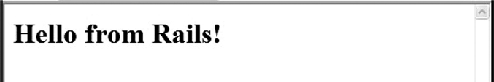
Figure 15.3 The reponse from rails1

Slide 5
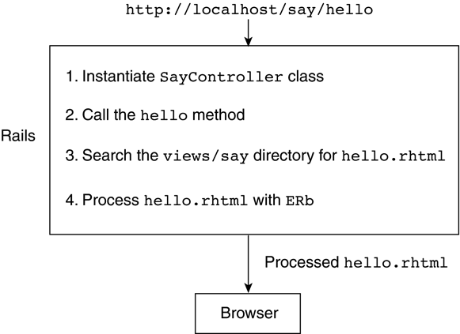
Figure 15.4 Rails actions for a simple request

Slide 6
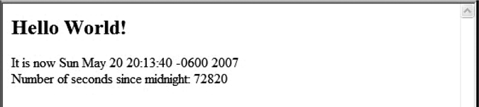
Figure 15.5 The output of rails2 (time/timer)

Slide 7
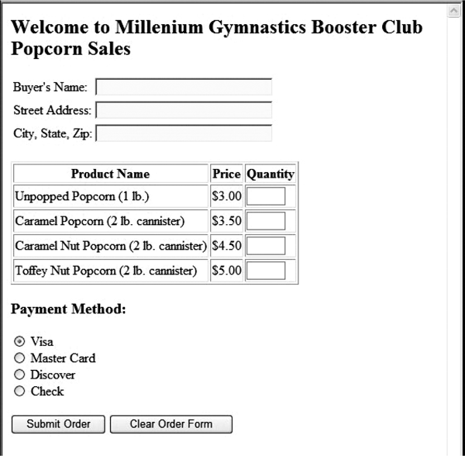
Figure 15.6 The popcorn application initial display

Slide 8
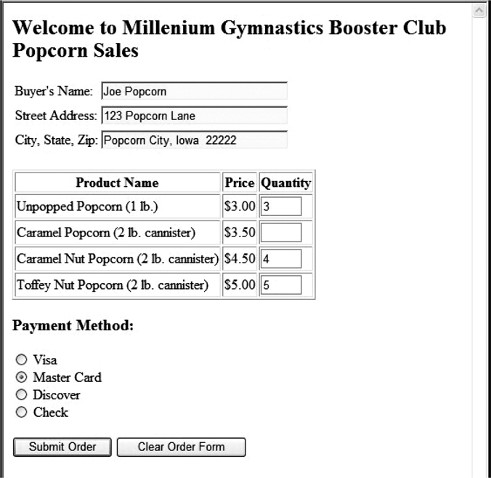
Figure 15.7 A completed popcorn order form

Slide 9
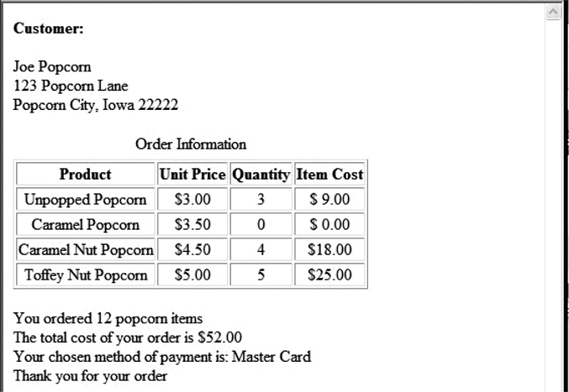
Figure 15.8 The result template to the customer

Slide 10
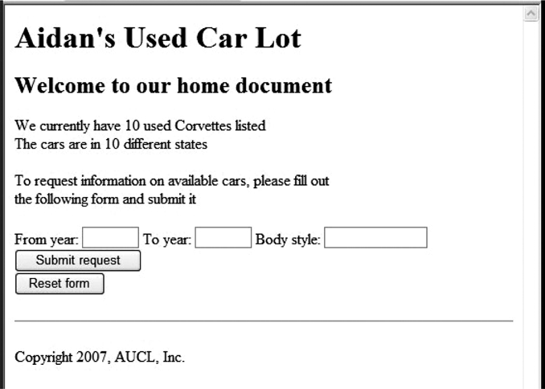
Figure 15.9 Display of welcome.rhtml

Slide 11
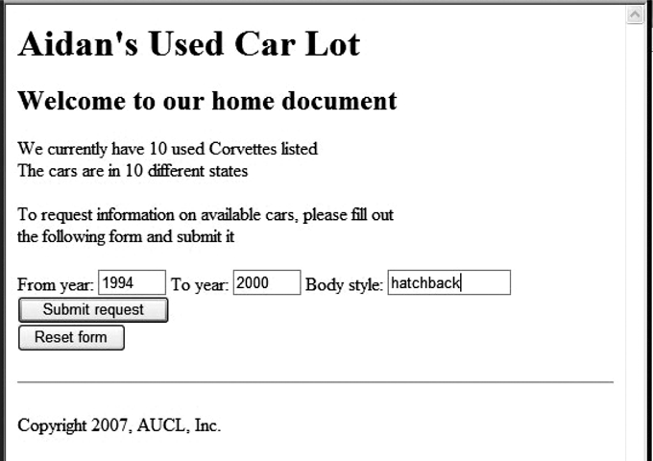
Figure 15.10 A filled–in welcome template for cars

Slide 12
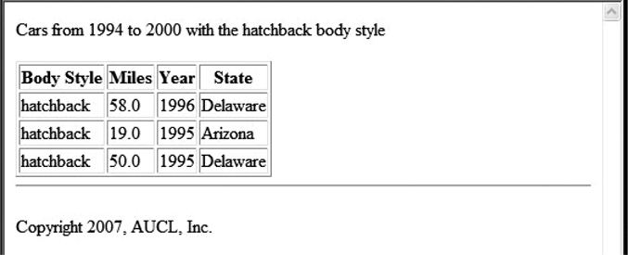
Figure 15.11 The result template for cars

